Slide 1

Title
NCCI 2022
CYBERBULLYING DETECTION USING MACHINE LEARNING ALGORITHMS
Member 1: Roshaan S II (IT) - 2127200801072
Member 2: Roheth S II (IT) - 2127200801071
Member 3: Shreya R II(IT) - 2127200801082
Guided by: Dr.N.Gobalakrishnan & Dr.D.Jayanthi, Assoc. Prof/INT

Slide 2
OUTLINE
Objective
Introduction
Limitations of existing system
Proposed methodology
Tech stack and development pipeline
Implementation of models
Performance Evaluation
Conclusion and Future Scope
References

Slide 3
PROBLEM STATEMENT
Objective:
To create a system that can detect cyberbullying comments.
Purpose:
This type of study can help people to detect early threats and possible criminal activities and the type of accounts to stay alert of in real time thereby creating a more secure social media experience and compare various sentiment analysis approaches for detecting bullying of threats from social media.

Slide 4
INTRODUCTION TO CYBERBULLYING
Cyberbullying is a kind of bullying which takes place in using electronic technology and communication. Mean text and images, embarrassing pictures and fake profiles are some examples.
Cyberbullying is continuing to grow as it is difficult to trace and it is distributed fastly.
So as to prevent this we have proposed a system to detect cyberbullying and display the results to the user.

Slide 5
LIMITATIONS OF EXISTING SYSTEM
The cyberbullying models generalize poorly across domains.
There is considerable overlap between toxicity classification and cyberbullying detection, and crowdsourced data yields well-performing cyberbullying detection models.
Lack of data.

Slide 6
PROPOSED METHODOLOGY
Our proposed system will analyze the sentence completely and interprets the input
This is done with the aid of sentimental analysis using Machine Learning
For the front end we have used HTML and CSS
For the backend connectivity we have used the Flask Framework.
The result of the input which is classified as Cyberbullying or not is displayed on the screen.

Slide 7




TECH STACK
System

Slide 8
DEVELOPMENT PIPELINE
Performing feature engineering to extract the features from the raw data
Display the prediction results as cyberbullying or not
DATA COLLECTION
DATA PROCESSING
ML MODELLING
PREDICTION
The dataset that is used here is Twitter data which is collected from Kaggle
After checking all the available algorithms with its accuracy, the system has been modelled using SGD Classifier Algorithm

Slide 9
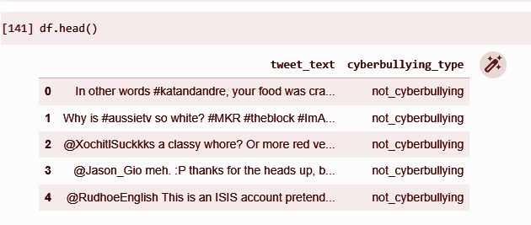
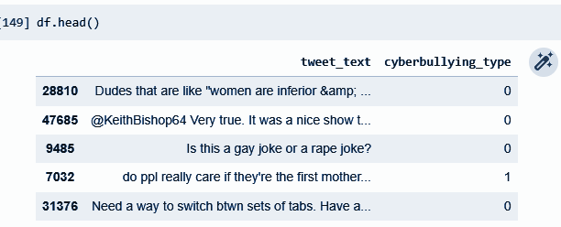
SAMPLE DATA

Slide 10
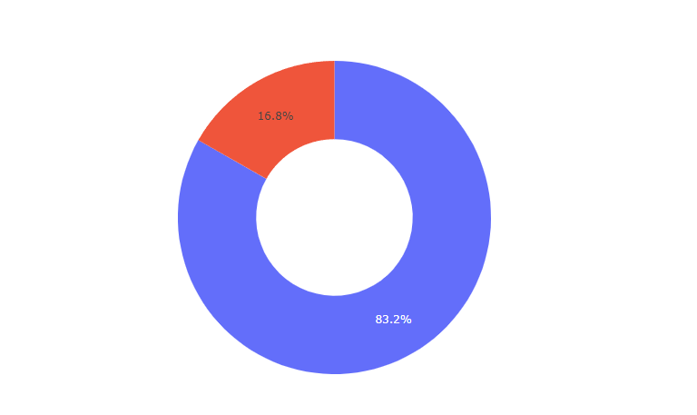
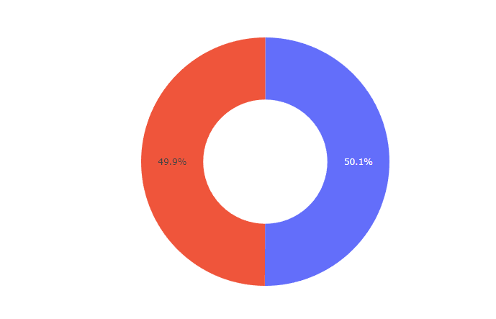
STATISTICS
Unbalanced data
Balanced data

Slide 11
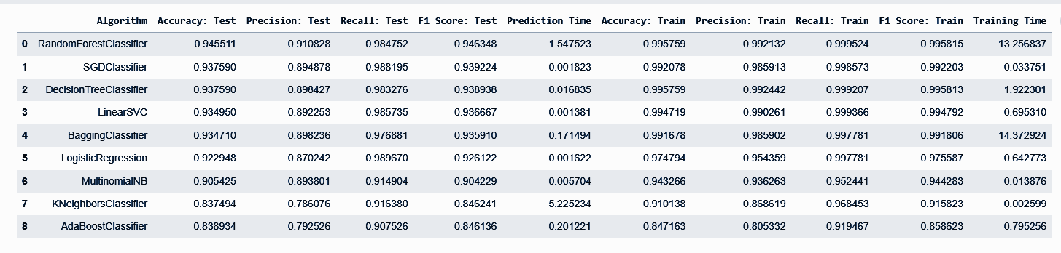
PERFORMANCE EVALUATION

Slide 12
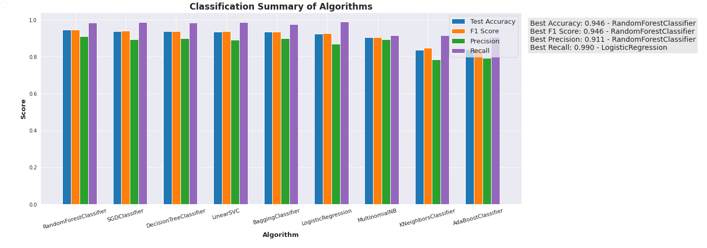
PERFORMANCE EVALUATION

Slide 13
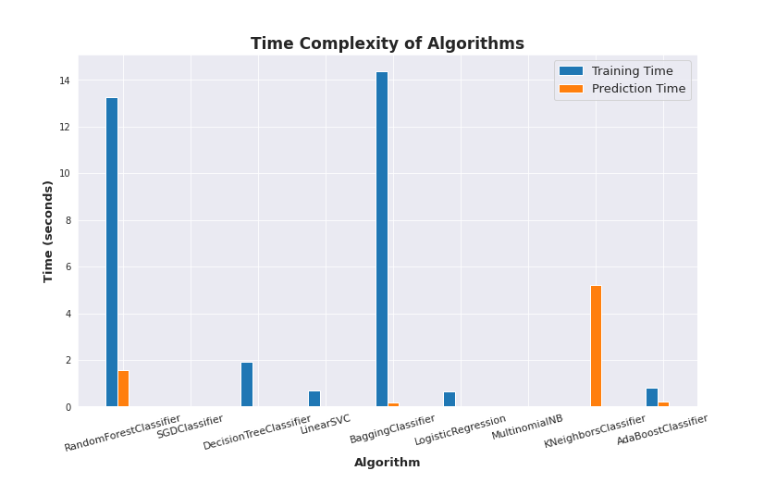
TIME COMPLEXITY OF ALGORITHMS

Slide 14
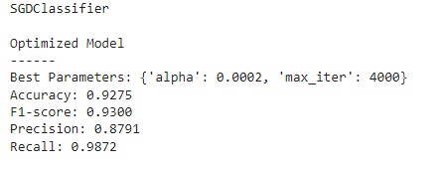
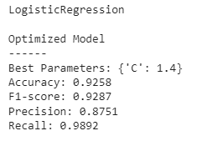
COMPARATIVE ANALYSIS
SGD Classifier
Logistic Regression

Slide 15
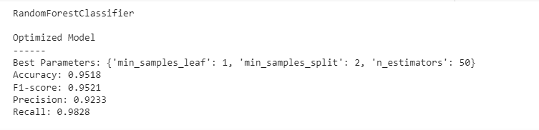
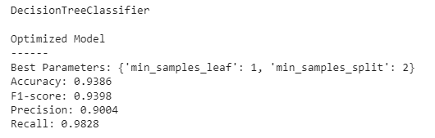
COMPARATIVE ANALYSIS
Random Forest Classification
Decision Tree Classification

Slide 16
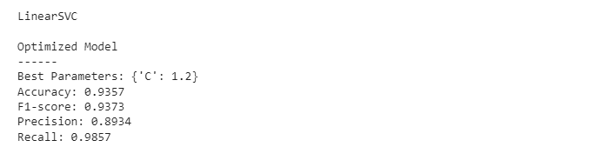
COMPARATIVE ANALYSIS
Linear SVC

Slide 17
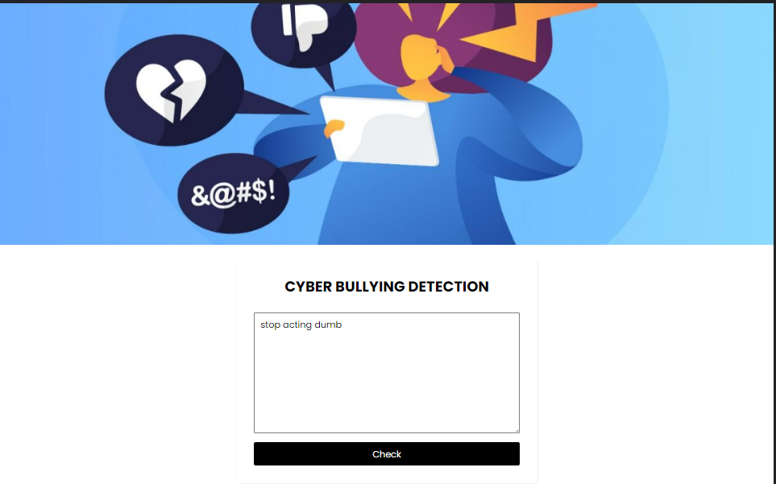

IMPLEMENTATION

Slide 18
CONCLUSION AND FUTURE SCOPE
In this work, we identified several issues that affect the majority of the current research on cyberbullying detection.
As it is difficult to collect accurate cyberbullying data in the wild, the field suffers from data scarcity.
In an optimal scenario, rich representations capturing all required meta-data to model the complex social dynamics of what the literature defines as cyberbullying would likely prove fruitful.
One can assume such access to remain restricted for the time being, and with current social media moving towards private communication, to not be generalizable in the first place. Thus, significant changes need to be made to the empirical practices in this field.
We provided a cross-domain evaluation setup and tested several cyberbullying detection models, under a range of different representations to potentially overcome the limitations of the available data.

Slide 19
CONCLUSION AND FUTURE SCOPE
A word may be tracked whether it is cyberbullying or not in the future, similar to how Grammarly gives us ideas for each and every phrase and how it corrects grammar.
This advanced approach may be employed in chat rooms and can also provide users with warnings.

Slide 20
REFERENCES
Cyber Bullying Detection on Social Media using Machine Learning Aditya Desai, Shashank Kalaskar, Omkar Kumbhar, and Rashmi Dhumal, ITM Web of Conferences 40, 03038 (2021).
A Comparative Analysis of Machine Learning Techniques for Cyberbullying Detection on Twitte,rArticle in Future Internet · October 2020.
Social Media Cyberbullying Detection using Machine Learning, Article in International Journal of Advanced Computer Science and Applications · January 2019.
Accurate Cyberbullying Detection and Prevention on Social Media, CENTERIS - International Conference on ENTERprise Informatation system.

Slide 21
REFERENCES
Prevention of Cyber Bullying using Machine Learning Techniques GMSN Gunawardana and WMKS Ilmini, Department of Computer Science, General Sir John Kotelawala Defence University, Ratmalana, Sri Lanka.
Cyberbullying Detection Using Machine Learning Aaminah Ali1,*, Adeel M. Syed2, Pakistan Journal of Engineering and Technology, PakJET.
Cyberbullying Detection in Syrian Slang on Social Media by using Data Mining, International Journal of Engineering Research & Technology (IJERT).
A systematic literature analysis of Cyberbullying Detection on social media using Text based Sentiment Analysis NIRJARI DESAI, PROF. MAYURESH KULKARNI, IJIRT

Slide 22
THANK YOU

